Slide 1
Digital Portfolio
STUDENT NAME: VASANTH K
REGISTER NO AND NMID: 2428C0524 & 53A46C48087ABE88AFC49A29FA2E3B31
DEPARTMENT: B.Sc - AIML
COLLEGE: KPR COLLEGE/ BHARATHIYAR UNIVERSITY

Slide 2
PROJECT TITLE
Yoga instructor Portfolio Website.

Slide 3


AGENDA
Problem Statement
Project Overview
End Users
Tools and Technologies
Portfolio design and Layout
Features and Functionality
Results and Screenshots
Conclusion
Github Link
3/21/2024 Annual Review

Slide 4

PROBLEM STATEMENT
In today’s fast-paced and stressful world, many people struggle to find effective ways to manage stress, improve physical health, and maintain mental well-being. Sedentary lifestyles, poor posture, and lack of mindfulness contribute to increasing rates of anxiety, chronic pain, and lifestyle-related illnesses. Despite the known benefits of yoga for holistic health, many individuals face barriers such as lack of guidance, motivation, or access to quality instruction tailored to their unique needs.

Slide 5

PROJECT OVERVIEW
Build a professional online portfolio for yoga instructors. Showcase yoga styles, skills, and teaching philosophy. Provide schedules, class information, and booking options. Improve visibility and attract new students through an engaging web platform. HTML → For structure and content.ML5 → For structure and content. CSS → For design, layout, and responsive styling. JavaScript → For interactivity (sliders, navigation, form validation). professional digital presence.

Slide 6

WHO ARE THE END USERS?
Working Professionals People managing work-related stress and sedentary lifestyles who want convenient and effective ways to improve physical and mental well-being, often through online or after-work classes.. Athletes and Fitness Enthusiasts Those looking to complement their training with yoga for injury prevention, flexibility, and recovery. corporate Clients and Organizations Companies interested in wellness programs to reduce employee stress, increase productivity, and promote a healthier work culture.

Slide 7

TOOLS AND TECHNIQUES
HTML CSS JavaScript Git and GitHub VS Code

Slide 8
PORTFOLIO DESIGN AND LAYOUT
HOME PAGE: Hero image with intro and motivational quote. ABOUT ME : Instructor bio, experience, and certifications. SERVICES: Details of yoga styles offered with icons/images. TESTIMONIALS : Student feedback in card layout. CONTACT: Form + social media links.
8

Slide 9
FEATURES AND FUNCTIONALITY
Variety of Classes: Different yoga styles (Vinyasa, Hatha, Yin, Prenatal) for all levels Flexible Scheduling: Online and in-person classes with easy booking and notifications Personalized Plans: Customized routines and private sessions tailored to individual goals Instructional Content: Videos, guided meditations, and written tips for practice support Community Engagement: Forums, social media sharing, and workshops to build connection Progress Tracking: User profiles to monitor growth and set wellness goals

Slide 10
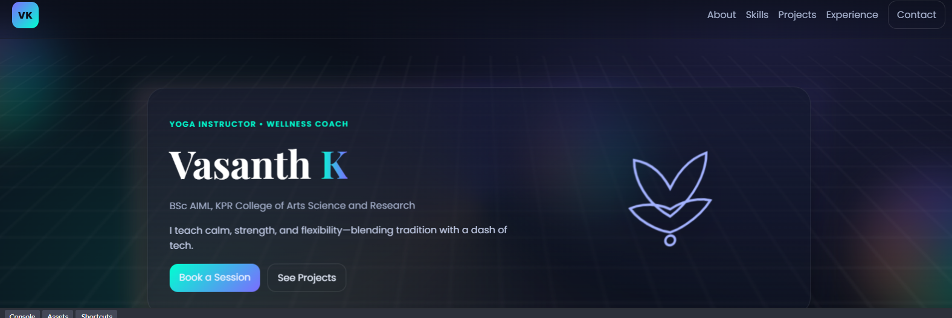

RESULTS AND SCREENSHOTS
3/21/2024 Annual Review
10

Slide 11
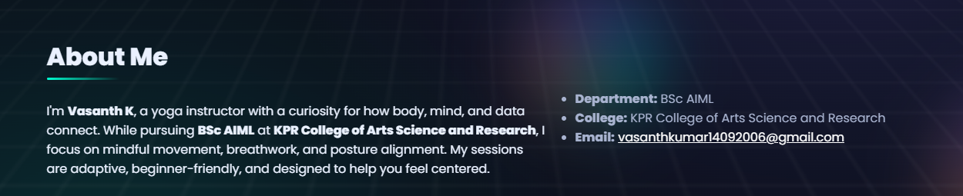
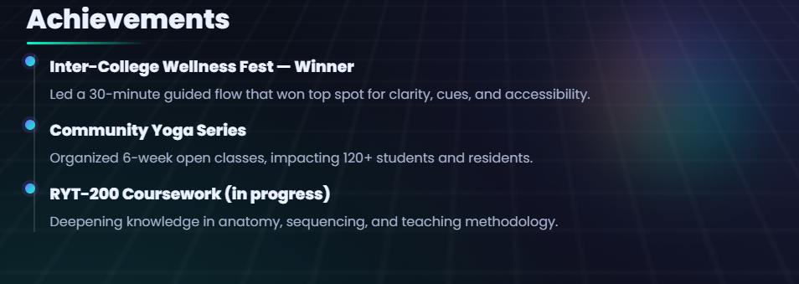
RESULTS AND SCREENSHOTS
3/21/2024 Annual Review
11

Slide 12
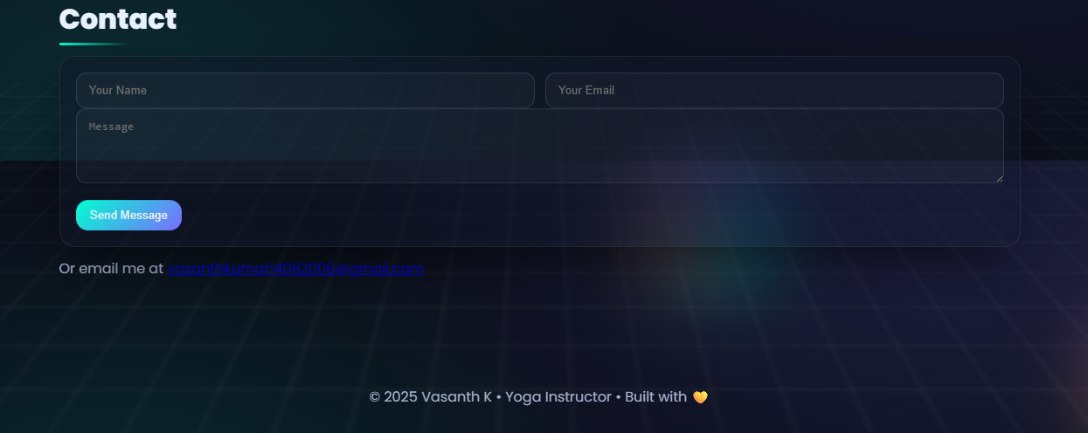
RESULTS AND SCREENSHOTS
3/21/2024 Annual Review
12

Slide 13
GITHUB LINK
https://github.com/vasanth668

Slide 14
CONCLUSION
Provides a professional online portfolio for the yoga instructor. Built using HTML, CSS, and JavaScript for structure, design, and interactivity. Showcases yoga styles, schedules, and instructor details. Ensures a responsive and user-friendly design across all devices. Helps students to connect easily and book sessions online.
14

